Slide 1


S4D400 - Introduction to abap programming on s/4hana
Anubhav Oberoy

Slide 2

Agenda – Day 3
Debugging
- Basic debugging in ABAP
- external and internal break points
- hard and soft break points
- stopping long running process
- debugging settings
- watch points and standard debugger
Working with Internal Tables
- Definition of an Internal Table
- Adding Data to an Internal Table Using the append Statement
- Reading Data from an Internal Table
- Sorting the Contents of an Internal Table
- Using Structures and Internal Tables
- Checking internal table
- Working between 2 internal tables
- Sort, delete and append data
- working with wa and itabs
- Control break statements
- Debugging

Slide 3

Debugging
Debugging is the process of detecting and removing of existing and potential errors (also called as 'bugs') in a software code that can cause it to behave unexpectedly or crash. To prevent incorrect operation of a software or system, debugging is used to find and resolve bugs or defects.

Slide 4

ABAP Debugger
The ABAP Debugger is used tool to execute and analyze programs line by line. Using it we can check the flow logic of a program and display runtime values of the variables.
Currently, SAP offers two types of Debuggers:
The Classic ABAP Debugger
The New ABAP Debugger
The Classic ABAP Debugger, with its old user interface and its limitations to debug certain types of ABAP program is now not in use by many new and old ABAP developers.

Slide 5
Exercise – Debugger Settings
Change Debugger settings, setup a session break point and check debugging.
Analyze debugging shortcuts.

Slide 6

Session v/s User breakpoint
Usually, you set session breakpoints in the ABAP Editor. The scope of session breakpoints is the current logon session. This means that your session breakpoints are present in all external sessions (i.e., SAP GUI windows) of the current logon session. If you select the Save button in the ABAP Debugger (in a dialog logon session), all current debugger breakpoints
are automatically converted to session breakpoints.
If you set a breakpoint inside the coding of a Web Dynpro, BSP or Fiori application, then the ABAP Workbench automatically sets a user breakpoint. User breakpoints are stored in the SAP database, and they are valid for all logon sessions of the current user on the current application server.
If you set a user breakpoint, then all following logon sessions of this user will have those breakpoints set

Slide 7
Exercise – External breakpoint
Change user name setting for debugging and examine User break point of another user.
Explore the different debugging window
Understand hard break point using BREAK-POINT

Slide 8
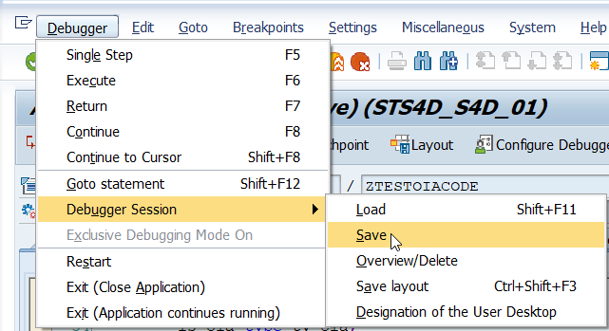
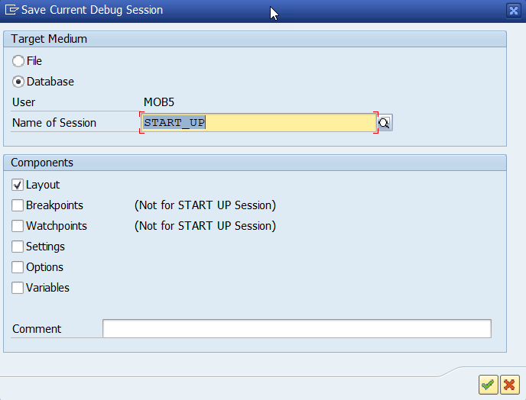
Saving debugging session
With the help of Debugger Variant you can save the current debugger settings into the database or to a local file. These settings include breakpoints, UI customizations and other special options for debugging tools.
Next time, when you will be debugging the same application you will not have to set breakpoints again or to do all the settings again. Also, when you are working in a large team then you can also pass the debugging variants to other users.
To save the ‘Debugging Variant’ go to Debugger→ Debugger Session→ Save

Slide 9
Exercise – Save session
Debug the code and save the break-point session to local computer, load the session and check the break point.

Slide 10
Statement breakpoint and /h
Statement break points allows us to stop control flow when a particular ABAP statement is triggered.
/h allows us to activate debugger on screen directly.
Often you will come across modal windows and other pop-up windows command line is not present and we cannot activate debugging directly. In such cases, you can either create a SAPGUI shortcut of type ‘System Command’ and command ’/h’ or create a text file with below texts.
[FUNCTION] Command=/H Title=Debugger Type=SystemCommand
To debug a modal window drag and drop the above created file over it.

Slide 11
Exercise – statement break and /h
- Explore the Statement break-point on existing abap program with WRITE statements
Use /h on any standard program
Debug a model window

Slide 12
The Magic of SHIFT + F12
You can use this key combination to bypass a specific line of code such as a normal sy-subrc check or an authorization check.
To jump or bypass any line/lines of code all you have to do is just put your cursor on the desired line and then press the SHIFT + F12 key.

Slide 13
Exercise – Shift+F12
Try putting cursor on a program and use Shift+F12 to observe the behavior of debugger flow.

Slide 14
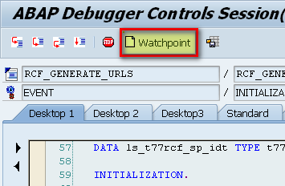
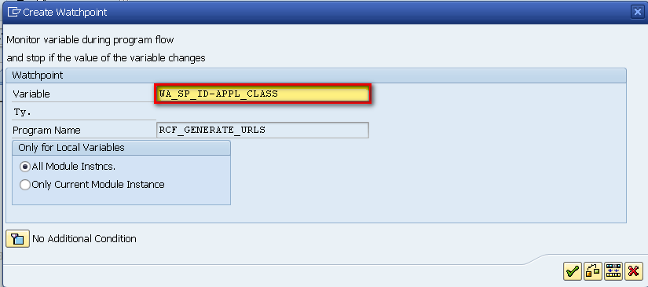
Watchpoints
Watchpoints can be used to break the execution of a program when the values in a variable changes.
This help us to go to the exact position where the variable changes. You can also specify conditions in Watchpoint and the execution of the program will break as soon as the condition is fulfilled.
To create a Watchpoint, click to the Watchpoint button in the New ABAP Debugger.
Now, in the Create Watchpoint pop up enter the variable name for which you want to create the Watchpoint.
Create Watchpoint Pop Up Enter The Variable Name

Slide 15
Exercise – Watch Points
Use an existing program to create watch points in the debugger.

Slide 16

Break

Slide 17
Internal Tables (data objects)
An internal table is a temporary table stored in RAM on the application server. It is created and filled by a program during execution and is discarded when the program ends. Like a database table, an internal table consists of one or more rows with an identical structure, but unlike a database table, it cannot hold data after the program ends. Use it as temporary storage for manipulating data or as a temporary private buffer.
An internal table consists of a body and an optional header line
The body holds the rows of the internal table. All rows within it have the same structure. The term "internal table" itself usually refers to the body of the internal table.
The header line is a field string with the same structure as a row of the body, but it can only hold a single row. It is a buffer used to hold each record before it is added or each record as it is retrieved from the internal table.
Header line
body

Slide 18
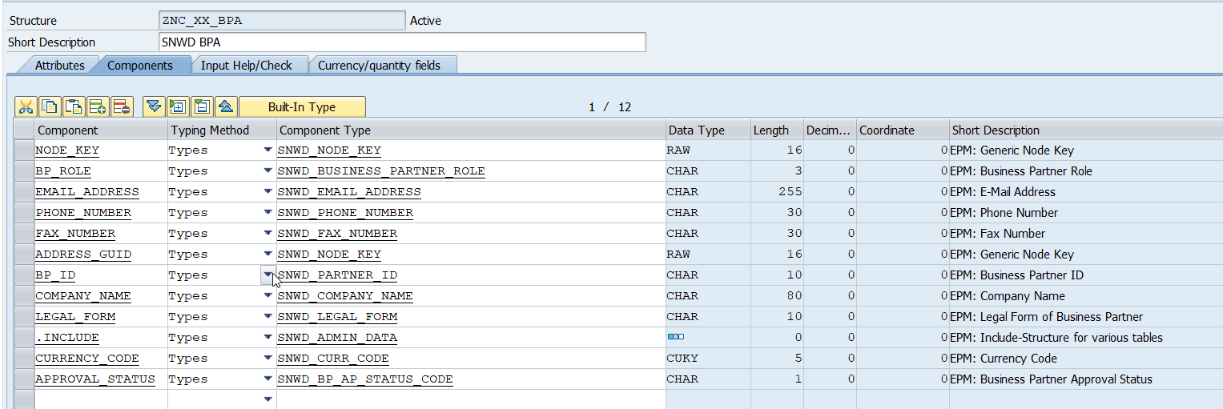
Exercise – Create table and load data
Create an new Structure for Business Partner ZNC_XX_BPA
Understand how to create table using existing DDIC structure with/without header line
Append multiple data records to an internal table
Program Name: ZNC_XX_ITAB

Slide 19
Reading Data from an Internal Table
Two statements are commonly used to read the data from an internal table:
loop at
read table
Use loop at to read multiple rows from the internal table. Use read table to read a single row.
Reading Multiple Rows Using the loop at Statement To read some or all rows from an internal table, you can use the loop at statement. Loop at… reads the contents of the internal table, placing them one at a time into a work area.

Slide 20
Syntax for the loop at Statement
The following is the syntax for the loop at statement.
loop at itab [into wa] [from m] [to n] [where exp].
---
endloop.
These lines are executed once for each row retrieved from the internal table.
The rows are read from the internal table one at a time and placed in succession into the work area. The lines of code between the loop at and endloop are executed for each row retrieved. The loop finishes automatically when the last row has been read, and the statement following the endloop is then executed.
The following points apply:
wa must have the same structure as a row of the body.
wa can be the header line or it can be any field string having the same structure as a row in the body.
If you do not specify a work area, by default the system uses the header line. For example, loop at it into it reads rows from the internal table it, placing them one at a time into the header line it. An equivalent statement is loop at it.
If from is not specified, the default is to begin reading from the first row.
If to is not specified, the default is to read to the last row.
Components of it specified in the logical expression should not be preceded by the internal table name. For example, where f1 = 'X' is correct, but where it-f1 = 'X' will cause a syntax error.
exp can be any logical expression. However, the first operand of each comparison must be a component of the internal table. For example, if it contains a component f1, then where f1 = 'X' would be correct; where 'X' = f1 would be incorrect and causes a syntax error.

Slide 21
Exercise – Loop at Itab
Understand the simple loop at internal table with work area.
Program Name: ZNC_XX_IT_LOOP

Slide 22
Reading a Single Row Using the read table Statement
To locate and read a single row from an internal table, use read table. It reads a single row that matches specific criteria and places it in a work area.
The following is the syntax for the read table statement.
read table it [into wa] [index i | with key keyexp [binary search] ] [comparing cmpexp] [transporting texp].
The following points apply:
wa must have the same structure as a row of the body.
wa can be the header line, or it can be any field string having the same structure as a row in the body.
If you do not specify a work area, by default the system uses the header line. For example, read table it into it reads one row from the internal table it, placing it into the header line it. An equivalent statement is read table it.

Slide 23
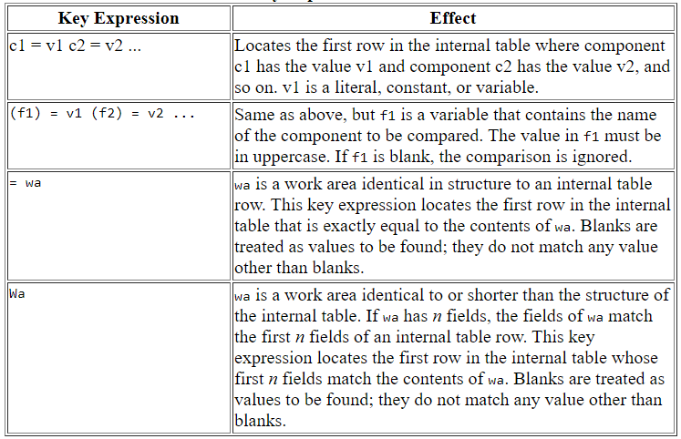
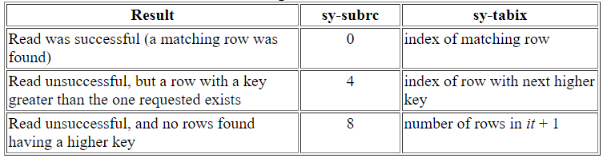
Read Table Expression
If with key keyexp is specified, the system finds a row that matches the key expression and places it in the header line.

Slide 24
Exercise – Read Table
Exercise to understand the Read table with
Simple Read
Sorting and binary Search
Dynamic Read conditions
Program Name: ZNC_XX_READ_ITAB

Slide 25
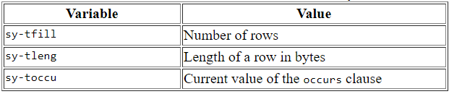
Obtain Internal Table info
Determining Whether an Internal Table Is Empty
If the body of an internal table contains only initial values (blanks and spaces), it is empty. Therefore, to determine whether an internal table contains any rows, test the body with the following statement:
if it[] is initial.
If the test is true, the internal table is empty. When false, it contains at least one row.
Determining the Number of Rows in an Internal Table
To determine the number of rows in an internal table, use the sy-tfill variable. It is set by the describe table statement.
Syntax for the describe table Statement
The following is the syntax for the describe table statement.
describe table it [lines i] [occurs j].

Slide 26
Internal Table Copy and Insert from another one
If two internal tables have the same structure, use the following statement to duplicate the contents of one internal table in another:
it2[] = it1[].
If you want to copy a portion of an internal table to another, or if you want to leave the contents of the target table in place, use the append lines and insert lines statements.
1. Use the append lines statement when you want to append rows to the end of the target table.
append lines of it1 [from nf] [to nt] to it2.
2. Using the insert lines Statement
insert lines of it1 [from nf] [to nt] into it2 [index nb].

Slide 27
Modify/Delete/Clear/Collect Rows into an Internal Table
To modify the contents of one or more rows of an internal table, use the modify statement.
modify it [from wa] [index n] [transporting c1 c2 ... [where exp]]
The following is the syntax for the clear statement when used with an internal table.
clear it | clear it[]
Using the delete statement, you can delete one or more rows from an internal table.
delete it (a) [index n]
(b) [from i] [to j]
(c) [where exp]
Using the collect statement, you can create totals within an internal table as you fill it.
collect [wa into] it.

Slide 28
Exercise – Internal Table Manipulation
Learn end to end internal table manipulation which includes, append, insert, modify, delete and collect data into the table
Program Name: ZNC_XX_CALC_ITAB

Slide 29
Exercise - Advance Internal Table
We can declare inline data declaration for internal table
We can also loop at internal table with field symbol
Perform loop at internal table as an object
Move data of internal table from table 1 to table 2 with Corresponding clause
Program Name: ZNC_XX_ADV_ITAB

Slide 30
Database Extraction
In ABAP/4 programming language, there are two types of SQL being used.
NATIVE SQL
OPEN SQL.
Open SQL allows you to access the database tables declared in the ABAP dictionary regardless of the database platform that the R/3 system is using. Native SQL allows you to use database-specific SQL statements in an ABAP/4 program. This means that you can use database tables that are not administered by ABAP dictionary, and therefore integrate data that is not part of the R/3 system.
Open SQL consists of a set of ABAP statements that perform operations on the central database in the R/3 system. The results of the operations and any error messages are independent of the database system in use. Open SQL thus provides a uniform syntax and semantics for all of the database systems supported by SAP. ABAP programs that only use Open SQL statements will work in any R/3 system, regardless of the database system in use. Open SQL statements can only work with database tables that have been created in the ABAP dictionary.
Basic Open SQL Commands are
SELECT – Read Data
INSERT – Create Data
UPDATE – Change Data
MODIFY – Insert + Update
DELETE – Remove Data

Slide 31
DB Abstraction – Pictorial View

Slide 32
Select Queries
There are broadly 4 different ways we can write SELECT query on database, the syntax depends on how much and where we want to load data.
Syntax:
SELECT [SINGLE] { select_clause FROM source } |{ FROM source FIELDS select_clause } [[FOR ALL ENTRIES IN itab] WHERE sql_cond] [GROUP BY group] [HAVING group_cond] [ORDER BY sort_key] INTO|APPENDING target [additional_options]. ... [ENDSELECT].
Select Queries
With Loop
SELECT * FROM dbtab.
….
ENDSELECT.
SELECT * FROM dbtab INTO wa.
….
ENDSELECT.
Without Loop
SELECT * FROM dbtab INTO TABLE itab
SELECT SINGLE * FROM dbtab INTO wa.

Slide 33
Exercise – Select Query Variations
Explore all the four variations of select queries in ABAP (Open SQL)
Understand INTO CORRESPONDING FIELDS OF
Inline Data Declaration
WHERE condition
SELECT…ENDSELECT
SELECT SINGLE
Program Name: ZNC_XX_SELECT

Slide 34
<Title>
<content>

Slide 35
End of Day 3

Slide 36

Questions

Slide 37

Anubhav Oberoy

